Slide 1

International Tennis Federation
Database of tennis players and tennis tournaments

Slide 2
Business requirements
The International Tennis Federation (ITF) stores information of all the tennis players and the tennis tournaments.
It needs a register of the Top 1000 players of both ATP (Men) and WTA (Women) rankings, including all the birthdates, nationalities, current ranking and organizations that they belong to.
It also needs a register of all the ATP, WTA and ITF tournaments of all the year 2021, including the starting dates, surfaces, countries and regions that the tournaments are played and categories that the tournaments belong to.
The ITF needs to know the ages, ranges of age, age average, ranges of ranking of all the Top 1000 players, divided by countries.
And also the ITF needs to know what places have most of the tournaments and in what surface they are played on, divided in starting date and categories.

Slide 3
Objectives
Identify the relationship between the number of players per country and their place in the ranking
Indicate the countries with the greatest difference between genders in their number of players in the Top 1000
Describe the relationship between the rankings and the age of the players
Indicate the number of tournaments in each region divided into quarters of the year
Identify the number of tournaments in each court surface divided into quarters of the year and identify patterns
Summarize the regions and surfaces of the tournaments filtered by categories and identify patterns

Slide 4
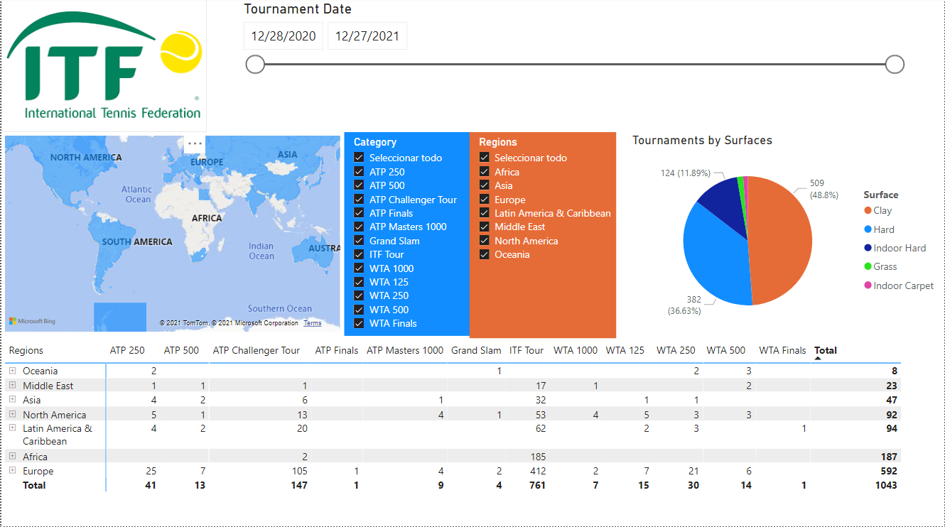
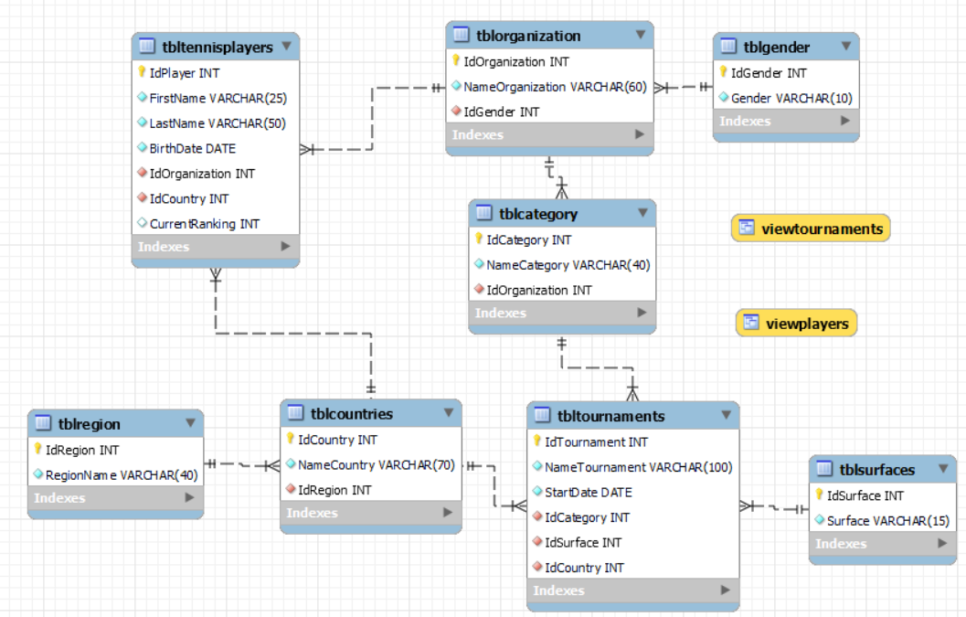
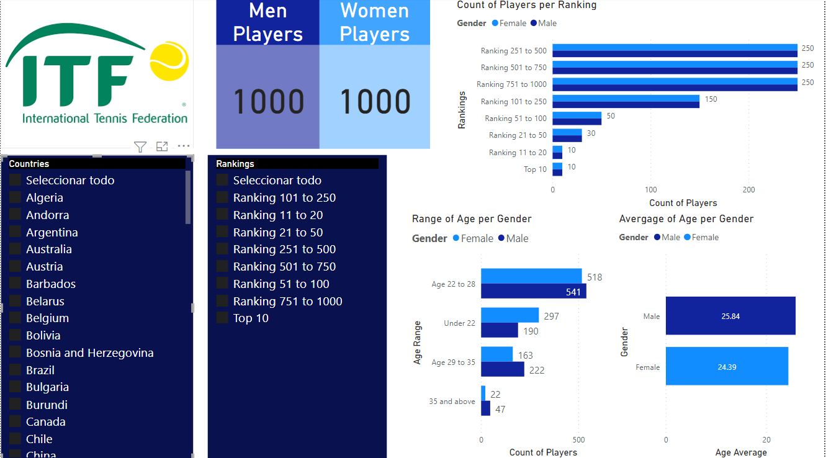
Dashboard Tournaments
Entity-Relationship Diagram
Dashboard Players

Slide 5
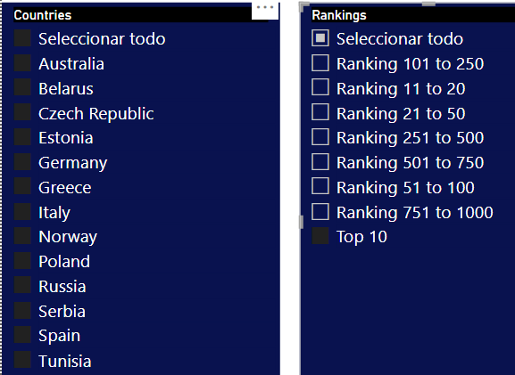
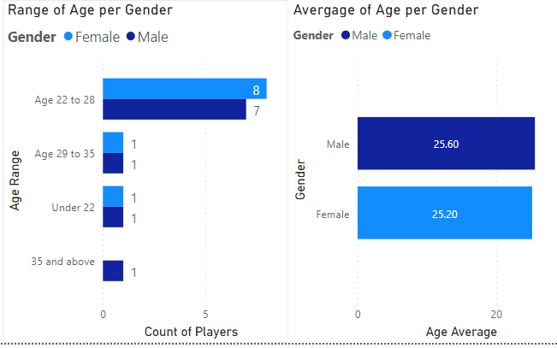
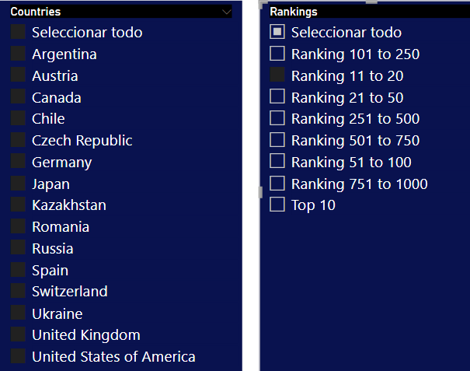
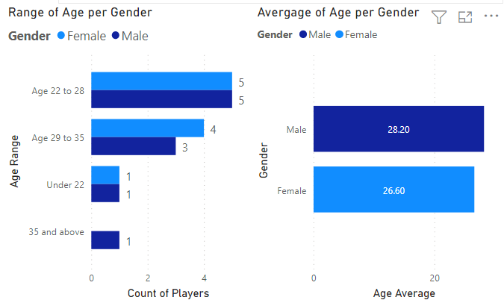
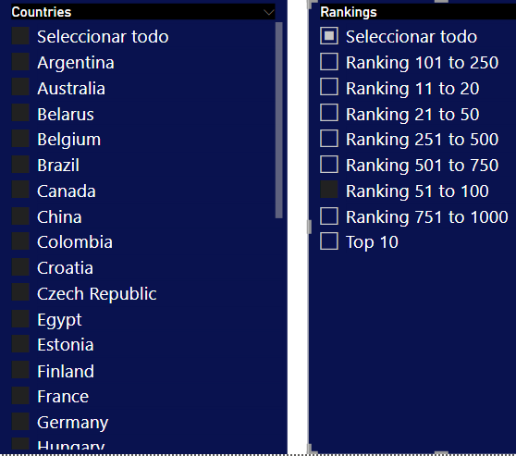
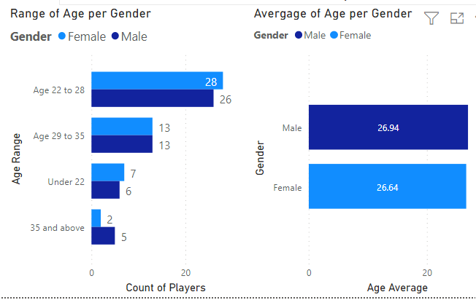
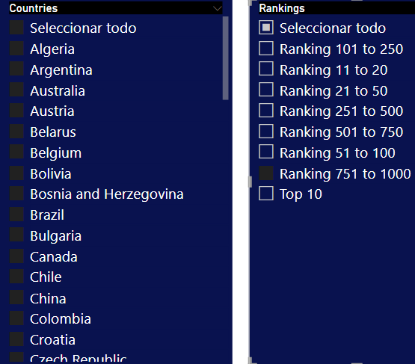
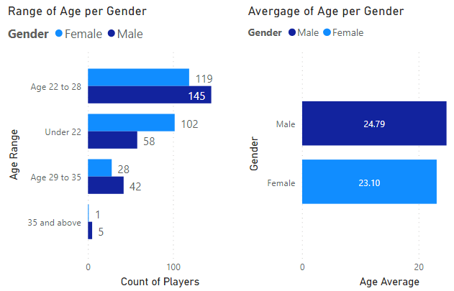
Rankings and age of the players
Top 10
Ranking 11 to 20
Ranking 51 to 100
Ranking 751 to 1000

Slide 6
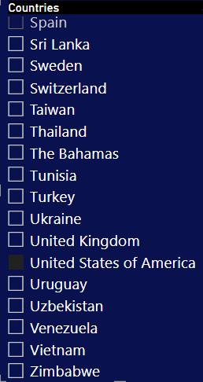
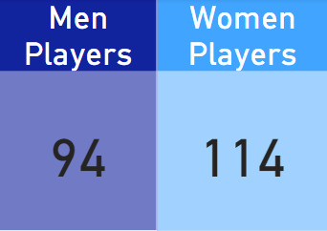
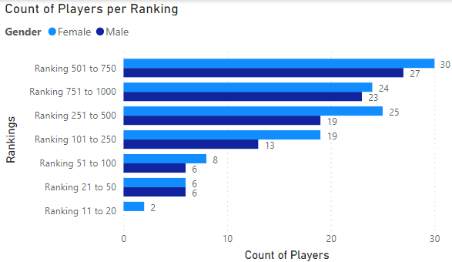
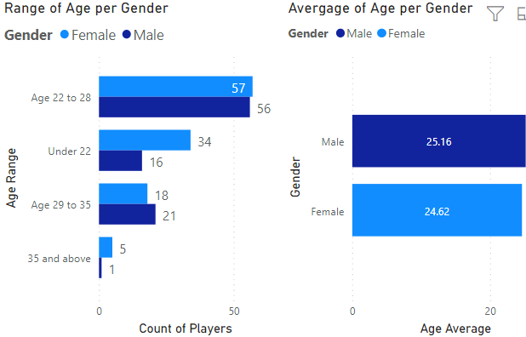
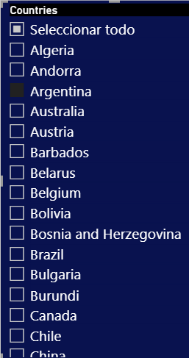
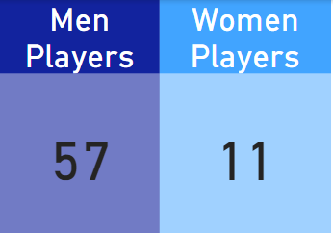
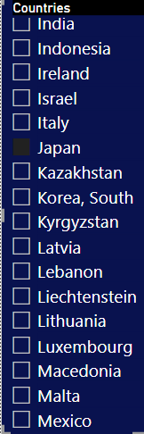
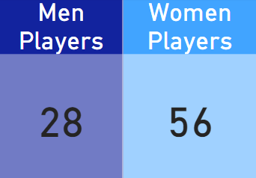
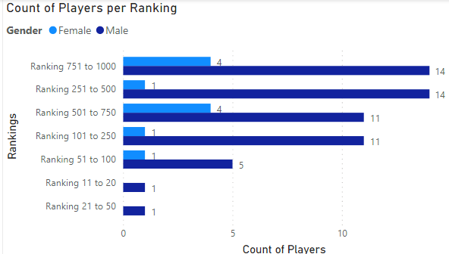
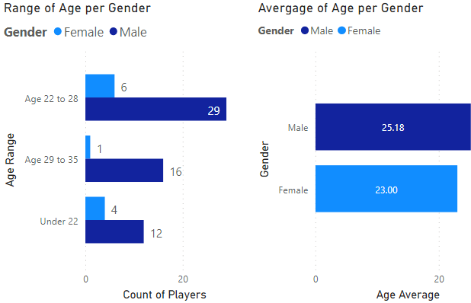
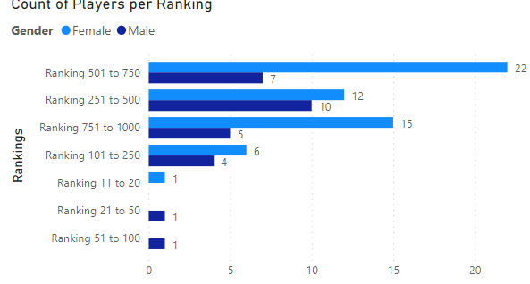
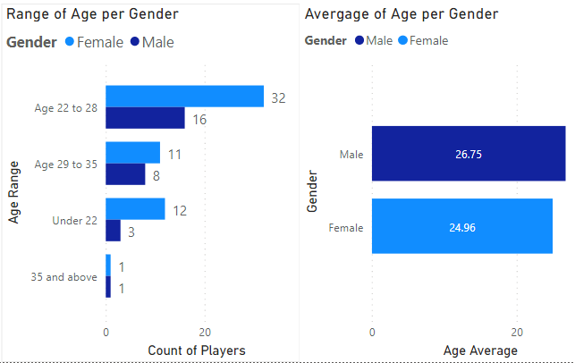
Gender and age of the players per country
United States of America
Argentina
Japan

Slide 7
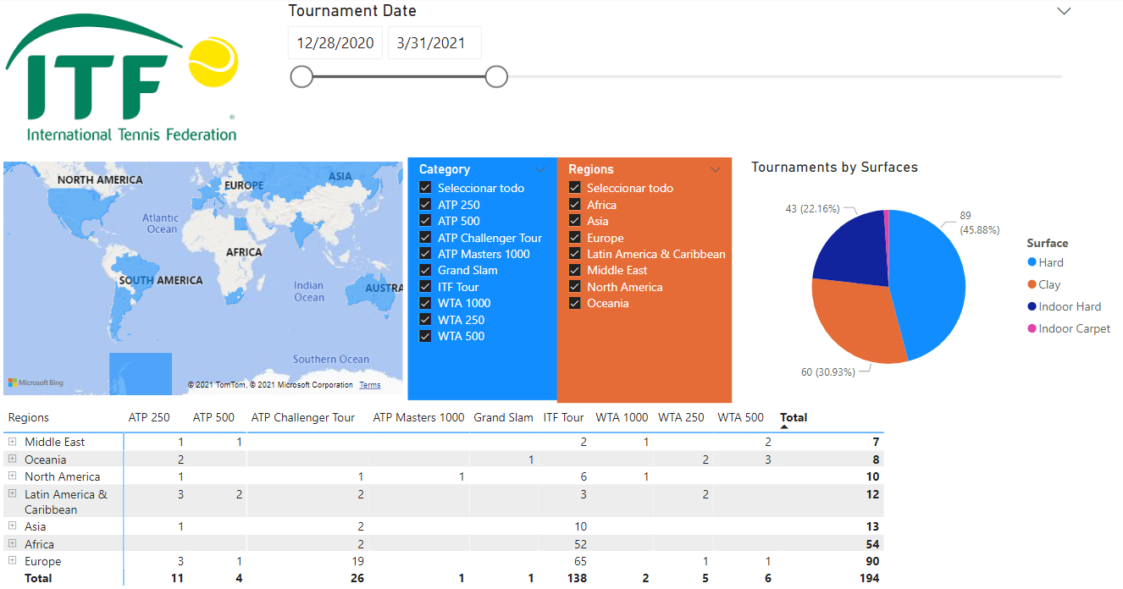
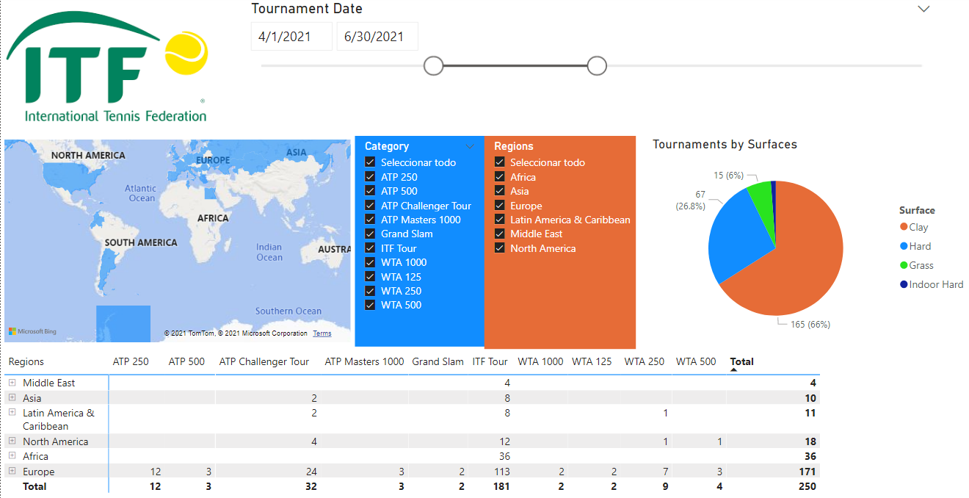
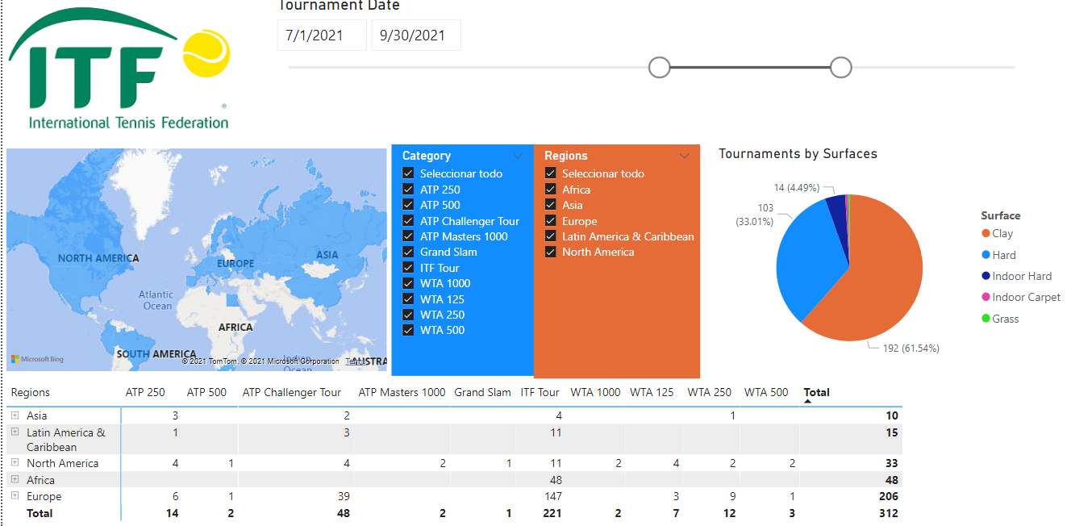
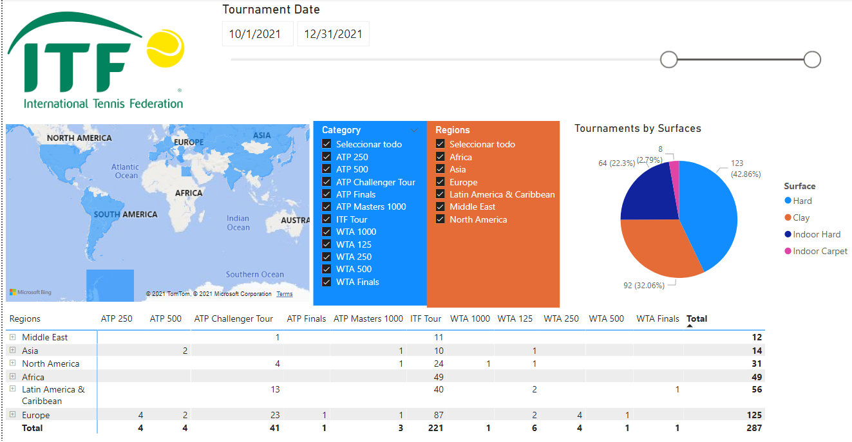
Tournaments by quarter periods
1st Quarter
2nd Quarter
3rd Quarter
4rd Quarter

Slide 8
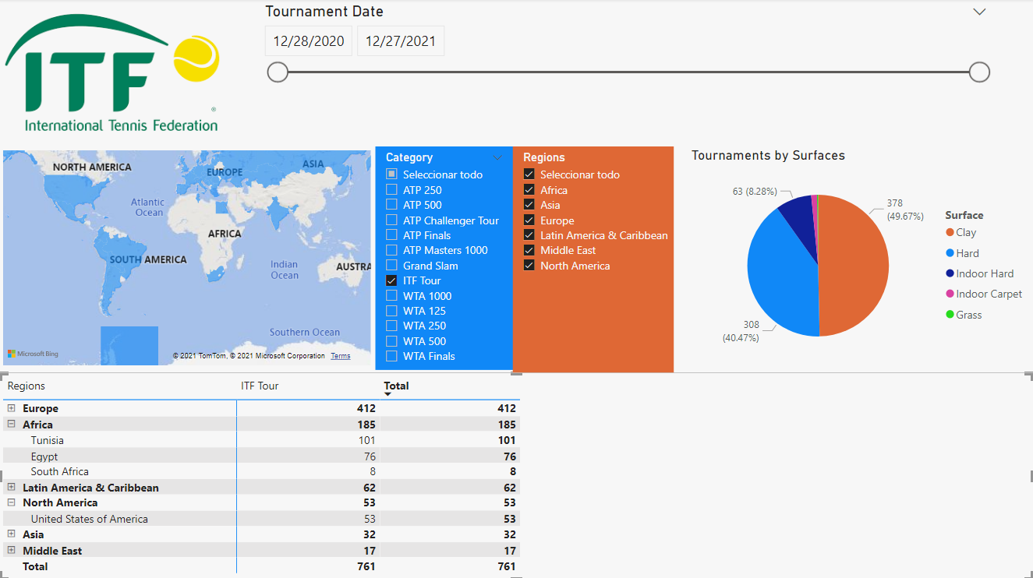
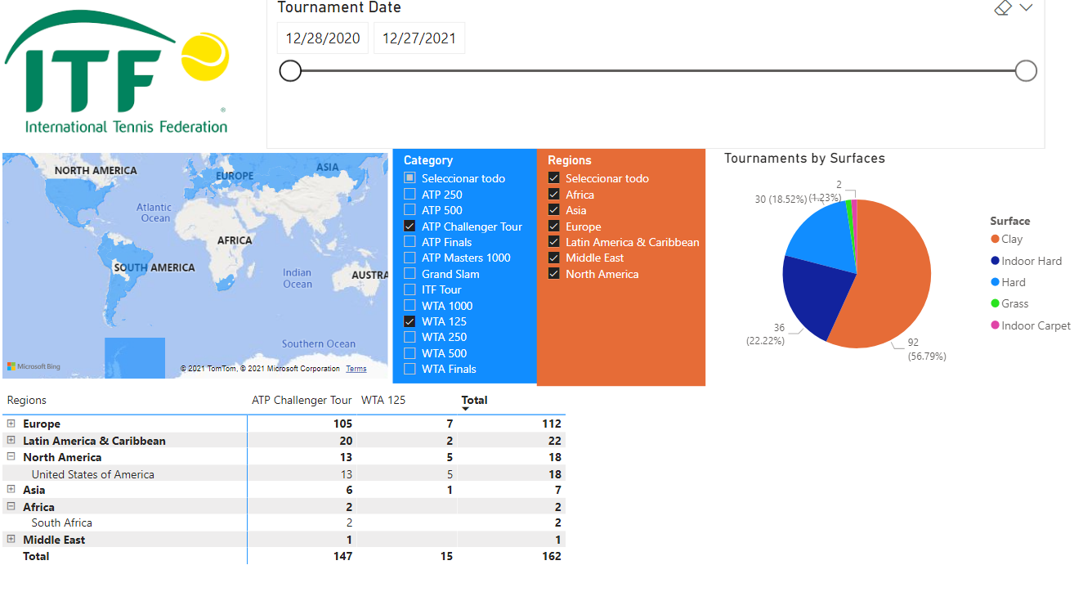
Tournaments by category
ITF Tournaments
ATP Challengers and WTA 125

Slide 9
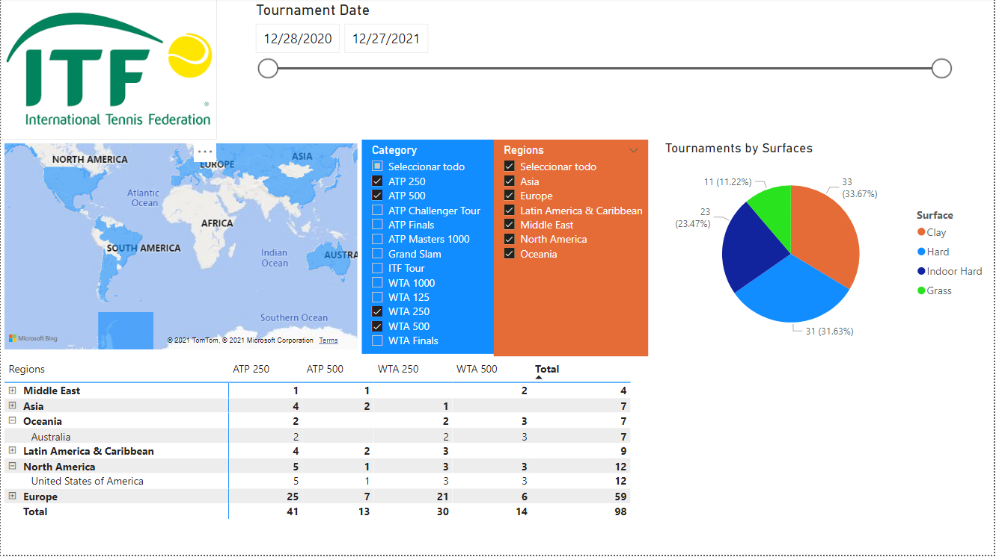
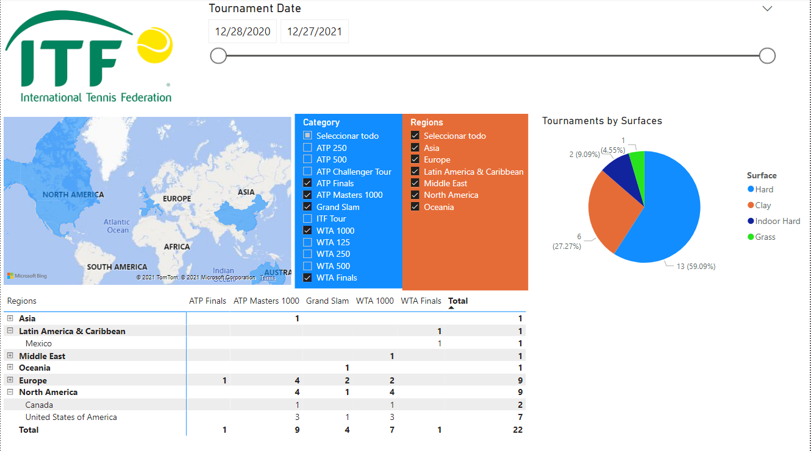
Tournaments by category
Masters 1000 - WTA 1000 - Grand Slams and ATP/WTA Finals
ATP/WTA 250 and 500

Slide 10
Conclusions
- There is no relationship between the number of players in the top 1000 and their consequent better position in the ranking. As we can see, the USA is the one with the most players and does not have any top 10 in any of the 2 rankings.
- The average age of men is always higher than the average age of women. In the general average age and in the average age by countries
- The countries with the greatest difference between men and women are Argentina and Japan. Argentina is one of the 5 with the most players in the top 1000, however it is very low in the number of women and Japan, on the other hand, it is among the 5 with the most women in the top 1000 and has few men. The average age of men in Argentina and women in Japan is very close to the general average
- Latin America has a serious problem regarding women's tennis, because as we can see, Argentina is the country with the largest number of players in Latin America, however, it is not among the top 20 countries with the largest number of women
- The average age, in both men and women, falls at the extremes of the ranking ranges: Top10 and ranking between 750 and 1000. In intermediate rankings, the average age rises

Slide 11
Conclusions
- In the first 3 quarters of the year, Europe and Africa are the 2 regions with the highest number of tournaments, however, in the last quarter, the region that follows Europe is Latin America
- Oceania only has tournaments in the 1st quarter of the year and the Middle East has no tournaments in the 3rd quarter
- In the 1st and 4th quarter there is a greater number of hard and indoor hard tournaments, while in the 2nd and 3rd quarter there are more clay tournaments (this happens specially for the European clay season)
- As the tournament category progresses, the surfaces change from clay to hard and indoor hard. In the minor tournaments (ITF, Challenger and WTA 125) there are more clay tournaments, and in the bigger tournaments the majority are played on hard.
- As the tournament category progresses, the tournaments move towards North America, which becomes the 2nd region with the most tournaments after Europe, displacing Africa ( in ITF tournaments) and Latin America ( in Challengers Tournaments and WTA 125)

Slide 12



